Slide 1




Powered by

Slide 2

SCOPE
Email Etiquette
Definition
Objectives
Key Components
Best Practices
Company (CIG) Format

Slide 3
PART 3
Email Etiquette
Company (CIG) Format

Slide 4
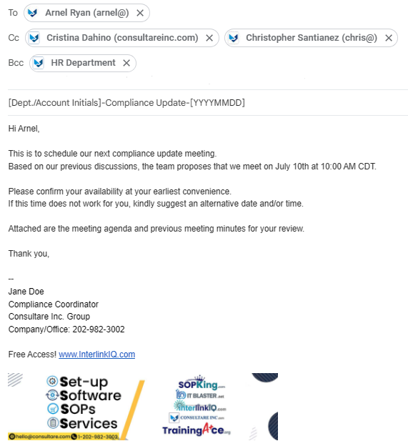
COMPANY (CIG) FORMAT – Key Components
Header/Recipients
Subject Line
Salutation
Body
Sign off/Closing
Signature

Slide 5
COMPANY (CIG) FORMAT – Email address
Email Etiquette
Corporate email address
Reflects the affiliation with the organization.
Example: janedoe@consultareinc.com
Centralized account email address
Use when communicating with the client and with the internal team concerning with the account handled.
Examples: services@consultareinc.com
csuccess@consultareinc.com

Slide 6
COMPANY (CIG) FORMAT – Email address
Email Etiquette
Temporary email address
Use for internal communications about personal or collaborative activities unrelated to the account being managed.
Examples: janedoe.qms@gmail.com
maecruz.ojt@gmail.com
Notes:
Temporary email addresses are used by CIG employees who have not yet been assigned a corporate email.

Slide 7
COMPANY (CIG) FORMAT – Subject line
Email Etiquette
Internal/Interdepartmental email subject line format
CIG Department initials (i.e., CIG, HR, IT, CMS, PCQI)
Main topic/Project/Document name
Action to be taken, if applicable
Date
Examples:
CIG-Holiday Notice-Independence Day-July 4, 2024
PCQI-QMS-2.2.2.P0-Document Control Program-For INT Review-20240703
PCQI-QMS-2.1.1.P0-Management Responsibility Program-For Conversion-OJT Task-20240630 (for OJT task)

Slide 8
COMPANY (CIG) FORMAT – Subject line
Email Etiquette
Internal/Account-specific email subject line format
Account’s initials (i.e., ABC [All Bread Company])
Main topic/Project/Document name
Action to be taken
Date
Examples:
ABC-Weekly Compliance Update-For INT Review-20240703
ABC-QMS-2.1.1.P0-Management Responsibility Program-For INT Approval-20240703
ABC-QMS-2.2.2.P0-Document Control Program-For Uploading-OJT Task-20240630 (for OJT task)

Slide 9
COMPANY (CIG) FORMAT – Subject line
Email Etiquette
External/Account-specific email subject line format
Account’s initials (i.e., ABC [All Bread Company])
Main topic/Project/Document name
Action to be taken
Date
Examples:
ABC-Weekly Compliance Update-20240703
ABC-QMS-2.1.1.P0-Management Responsibility Program-For Approval-20240703

Slide 10
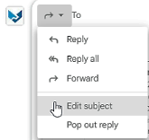
COMPANY (CIG) FORMAT – “Reply All” & “Forward”
Email Etiquette
When replying to all the recipients and/or forwarding records to the internal team, do not forget to click ‘Edit subject’ and remove ‘Re:’ and/or ‘Fwd:’
Examples:
Reply All
Re: ABC-Weekly Compliance Update-For INT Approval-20240703
Forwarding message
Fwd: ABC-QMS-2.1.1.P0-Management Responsibility Program-20240703

Slide 11
COMPANY (CIG) FORMAT – Standard Formatting
Email Etiquette
Font Style: Sans Serif
Font Size: Normal
Font Color: Black
Background Text Color: White
For FSQA inquiries or any question/s from the client:
Client’s question – the word “Question” is highlighted in yellow
CIG response – the word “Response” is highlighted in green

Slide 12
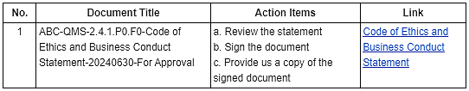
COMPANY (CIG) FORMAT – Standard Formatting
Email Etiquette
For table/s
Header: Align center, bold text
Number sequence: Align top center
Contents: Align top left
Borders: All

Slide 13
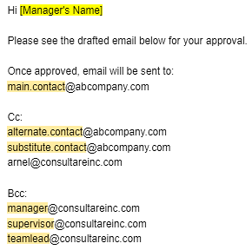
COMPANY (CIG) FORMAT – Recipients (Client-ready)
Email Etiquette
For INT review and/or approval
List of email recipients is included to verify that the sender has the correct email recipients.
Example:

Slide 14
COMPANY (CIG) FORMAT – Receiving email from client
Email Etiquette
Client’s email can be a:
meeting schedule confirmation
request
clarification or inquiry
submission of records or documents

Slide 15
COMPANY (CIG) FORMAT – Receiving email from client
Email Etiquette
Acknowledge receipt
  Reply promptly to acknowledge that you have received the email.
  Include duration on when the request/task will be addressed.
  Examples:
    Within shift – meeting schedule confirmation, records/documents for upload and provided links (that do not require extensive assessment).
  2 to 3 business days – document (PFL) creation/update, FSQA queries, bulk SAP/FSVP/Compliance records for assessment, other compliance activities.
  More than 3 business days – depends on the project milestone.

Slide 16
COMPANY (CIG) FORMAT – Follow up email
Email Etiquette
Original and follow-up emails are included in the email thread.
Example:
Sending email for Follow up No. 2 – copy and paste the original/initial and follow up no. 1 emails below the drafted 2nd follow up.
Follow up interval has a standard of three (3) business days.
In some cases, follow up interval may vary depending on the client’s preference.

Slide 17
COMPANY (CIG) FORMAT – Follow up email
Email Etiquette
For clients who do not prefer follow ups through email:
Utilize the agenda and minutes of the meeting.
For clients who took long time to response, and already reached the 3rd follow up:
Request assistance from the Customer Success Team to do the follow up via phone call.

